Slide 1
SE 434 01 Social Network Analysis Term Project II
Analysis of Comedy Movies Actors/Actresses in Turkish Cinema by History using Complex Network Analysis
Fatmanur Akbaş 16 07 06 027
Tevhit Karslı 16 07 06 017

Slide 2
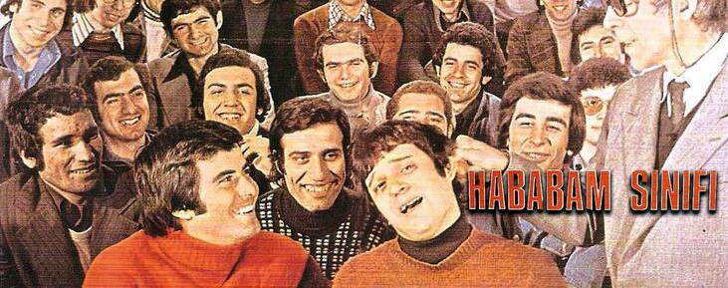
Yeşilçam Period, 1970-1989

Slide 3

Todays, 2018 and 2019

Slide 4
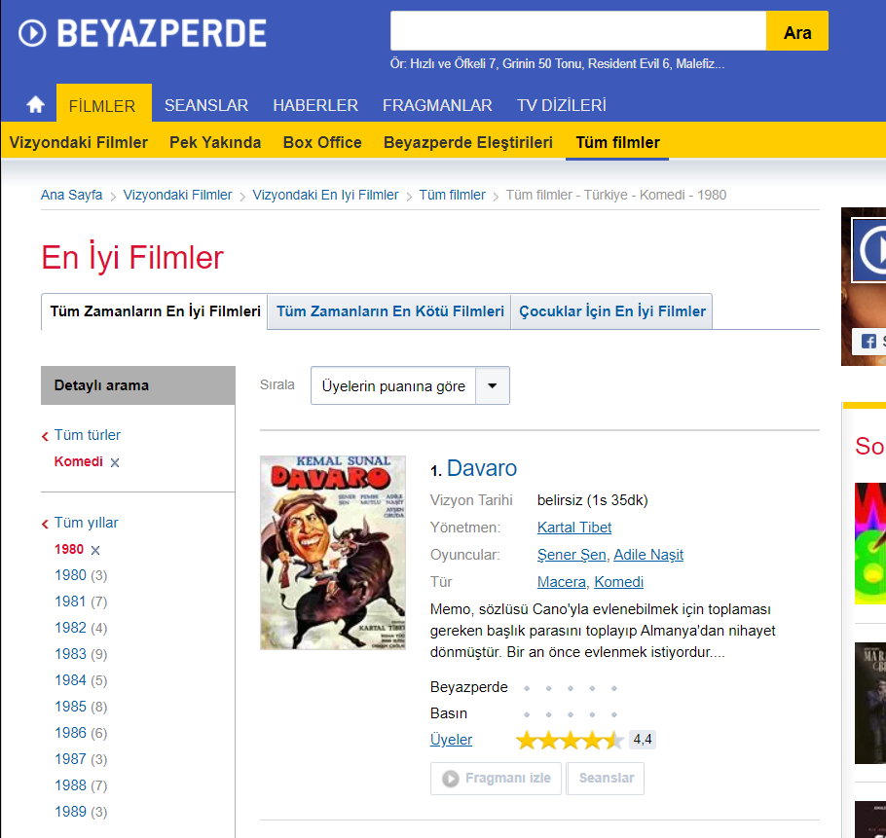
Data Collection: Manually, Python CSV converter, import CSV to Gephi

Slide 5
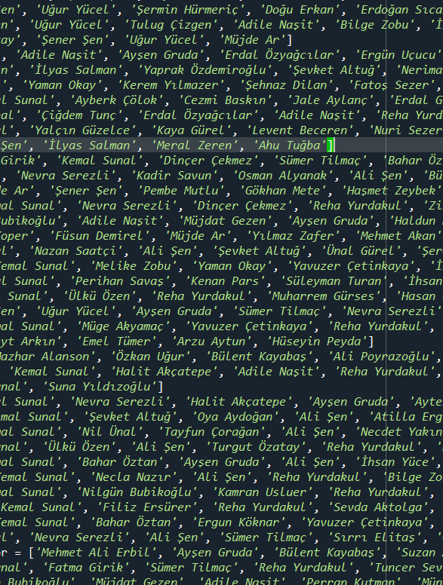
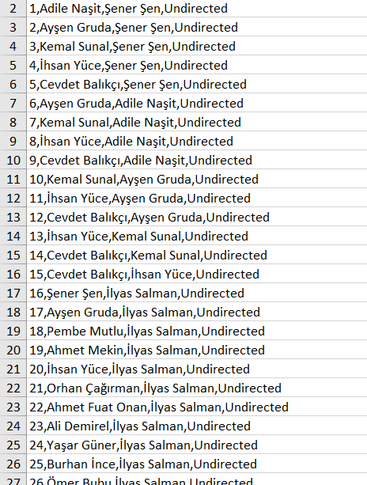
All Data Shared in our GitHub Accounts
https://github.com/fatmanurakbass/ActorsNetworkAnalysis
https://github.com/Tevhit/FilmsNetworkAnalysis

Slide 6
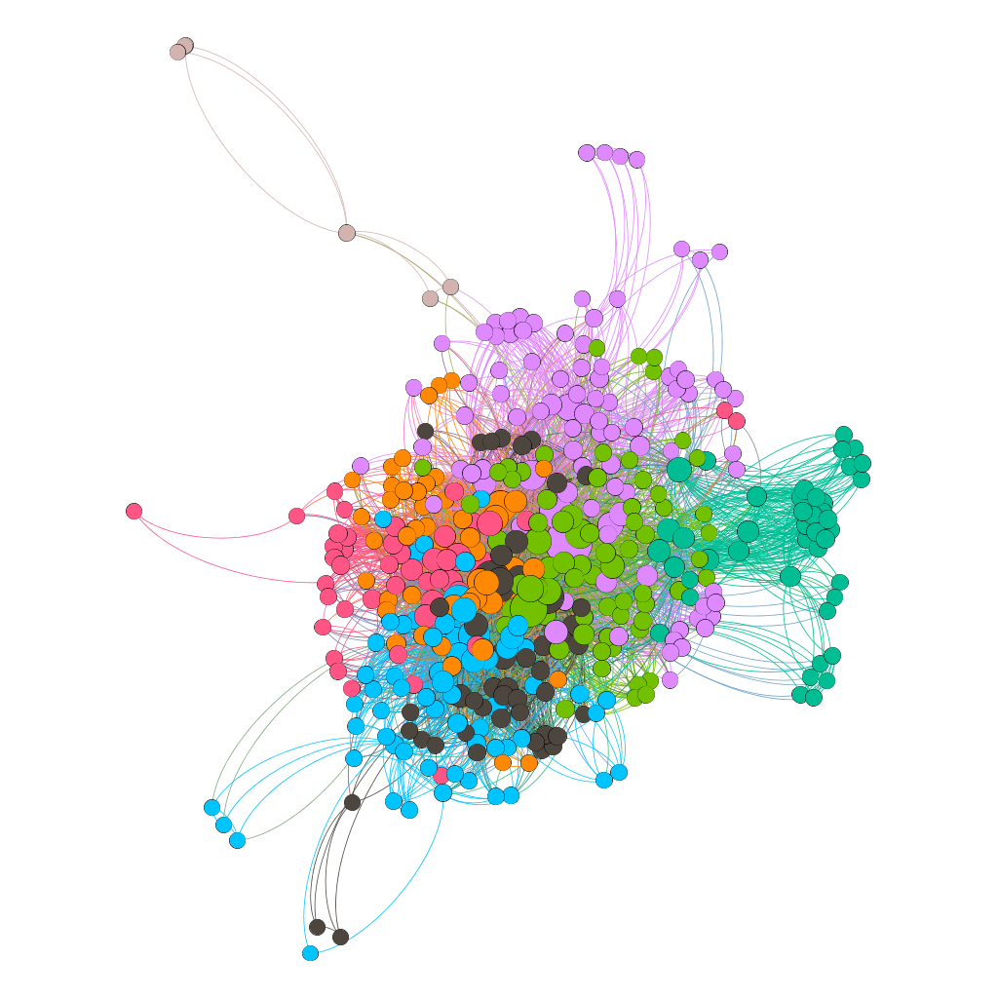
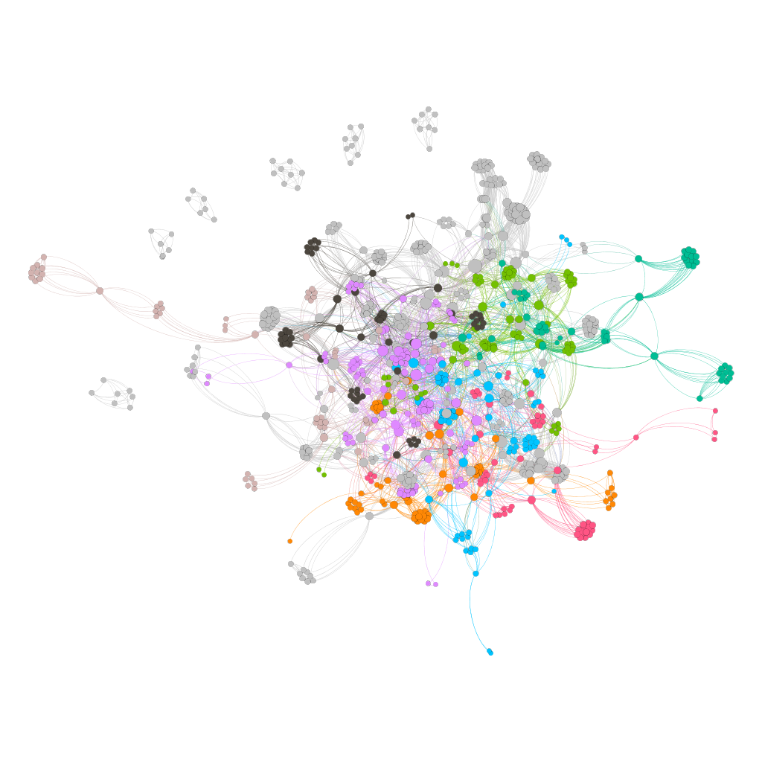
Actors playing in 1970-1989 Turkish Comedy Films Network
Actors playing in 2018 and 2019
Turkish Comedy Films Network

Slide 7
 | Actors playing in 1970-1989 Turkish Films Network | Actors playing in 2018 and 2019 Turkish Films Network
Nodes | 424 | 894
Edges | 5464 | 6086
Clustering Coefficient | 0,743 | 0,887
Avg. Path Length | 2,273 | 3,645
Density | 0,061 | 0,015
Avg. Weighted Degree | 25,774 | 13,613
Diameter | 5 | 7

Slide 8
Top 10 Actors by their Degree Centralities
Rank | Actor | Degree
1 | Kemal Sunal | 230
2 | Ali Şen | 159
3 | İhsan Yüce | 157
4 | Kenan Fosforoğlu | 128
5 | Cevat Kurtuluş | 118
6 | Adile Naşit | 116
7 | Hulusi Kentmen | 113
8 | Ayşen Gruda | 106
9 | Ahmet Turgutlu | 102
10 | Reha Yurdakul | 102
Rank | Actor | Degree
1 | Sinan Bengier | 64
2 | Erkan Can | 52
3 | Ali Rıza Tanyeli | 51
4 | Uraz Kaygılaroğlu | 50
5 | Toygan Avanoğlu | 48
6 | Şafak Sezer | 48
7 | Esra Sönmezer | 47
8 | Çetin Altay | 45
9 | Ayhan Taş | 44
10 | Doğa Konakoğlu | 43

Slide 9
Top 10 Actors by their Closeness Centralities
Rank | Actor | Closeness
1 | Kemal Sunal | 0.68336
2 | Hakkı Kıvanç | 0.604286
3 | Ali Şen | 0.59915
4 | İhsan Yüce | 0.584254
5 | Kenan Fosforoğlu | 0.582645
6 | Adile Naşit | 0.573171
7 | Hulisi Kentment | 0.568548
8 | Ayşen Gruda | 0.563249
9 | Reha Yurdakul | 0.556579
10 | Cevat Kurtuluş | 0.547927
Rank | Actor | Closeness
1 | Haydar Zeytünlü | 1.0
2 | Furkan Tezcan | 1.0
3 | Turgut Güneş | 1.0
4 | Kenan Balık | 1.0
5 | Belit Şentürk | 1.0
6 | Soner Karakuş | 1.0
7 | İlker Su Osmanoğlu | 1.0
8 | İsmail Suat Tuzlu | 1.0
9 | Onur Dilber | 1.0
10 | Ümit İbrahim Kantarcılar | 1.0
Notes:
closityleri 1.0 çünkü kenarda ufak topluluklar oluşmuş onlar birbiriyle tam bağlantılı

Slide 10
Top 10 Actors by their Betweenness Centralities
Rank | Actor | Betweenness
1 | Kemal Sunal | 0.201897
2 | Hakkı Kıvanç | 0.057888
3 | Ali Şen | 0.054848
4 | İhsan Yüce | 0.048333
5 | Adile Naşit | 0.039050
6 | Kenan Fosforoğlu | 0.038148
7 | Şener Şen | 0.037158
8 | Ayşen Gruda | 0.033591
9 | Cevat Kurtuluş | 0.032582
10 | Müjde Ar | 0.032478
Rank | Actor | Betweenness
1 | Sinan Bengier | 0.077718
2 | Ayhan Taş | 0.071007
3 | Ali Rıza Tanyeli | 0.061317
4 | Toygan Avanoğlu | 0.059659
5 | Şafak Sezer | 0.048302
6 | Bengi İdil Uras | 0.047691
7 | HÜseyin Elmalıpınar | 0.046185
8 | Erkan Can | 0.041119
9 | Esin Civangil | 0.040975
10 | Uraz Kaygılaroğlu | 0.040664

Slide 11
Community Analysis
Community Id | Number of Element | Community Color
1 | 93
4 | 73
6 | 66
5 | 50
0 | 48
7 | 45
3 | 43
2 | 6
Community Id | Number of Element | Community Color
16 | 74
9 | 62
18 | 60
7 | 59
12 | 57
3 | 53
25 | 49
23 | 48
4 | 44
8 | 41
6 | 40
14 | 36
1 | 35
15 | 33
11 | 31
17 | 31
10 | 29
13 | 28
2 | 27
5 | 14
0 | 8
20 | 8
21 | 7
22 | 6
19 | 6
24 | 6

Slide 12
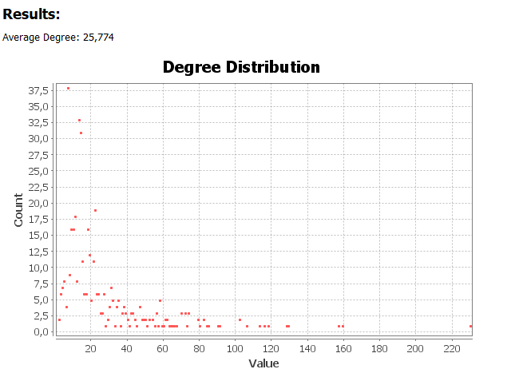
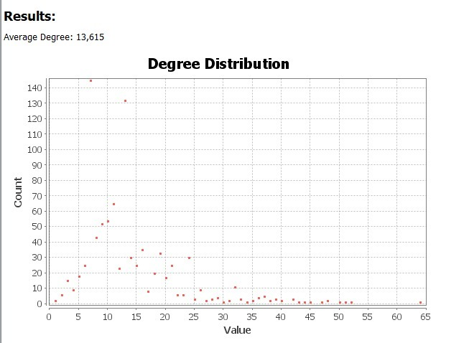
Degree Distribution

Slide 13
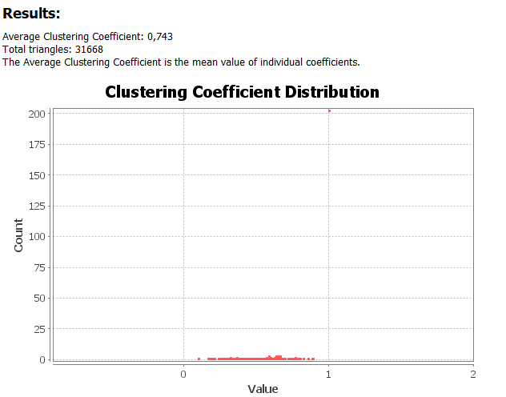
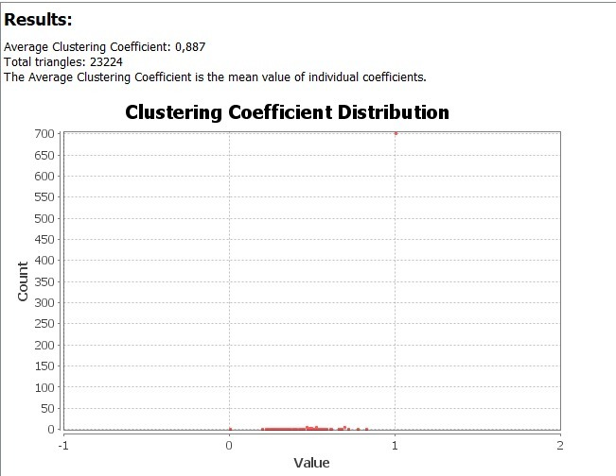
Clustering Coefficient Distribution

Slide 14
Density
n: node
m: edge
Calculating with Non-directional Network:
m / (n * (n-1) / 2)
number of maximum edges : (424*421) / 2 = 89.252
density : 5464 / 89.252 = 0.061
number of maximum edges : (894*893) / 2 = 399.171
density : 6086 / 399.171 = 0.015

Slide 15
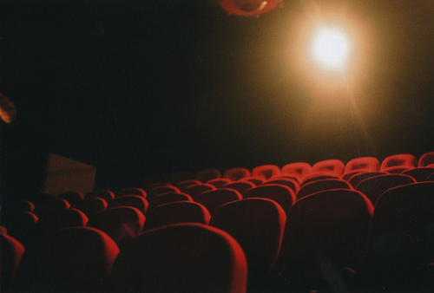
Thanks for Listening.. ☺

